Slide 1
VISUAL EXPLORATORY DATA ANALYSIS OF COMPANIES THAT ATTAINED UNICORN STATUS.
BY STEPHEN OLUWI
QUANTUM ANALYTICS APRIL COHORT 2023

Slide 2
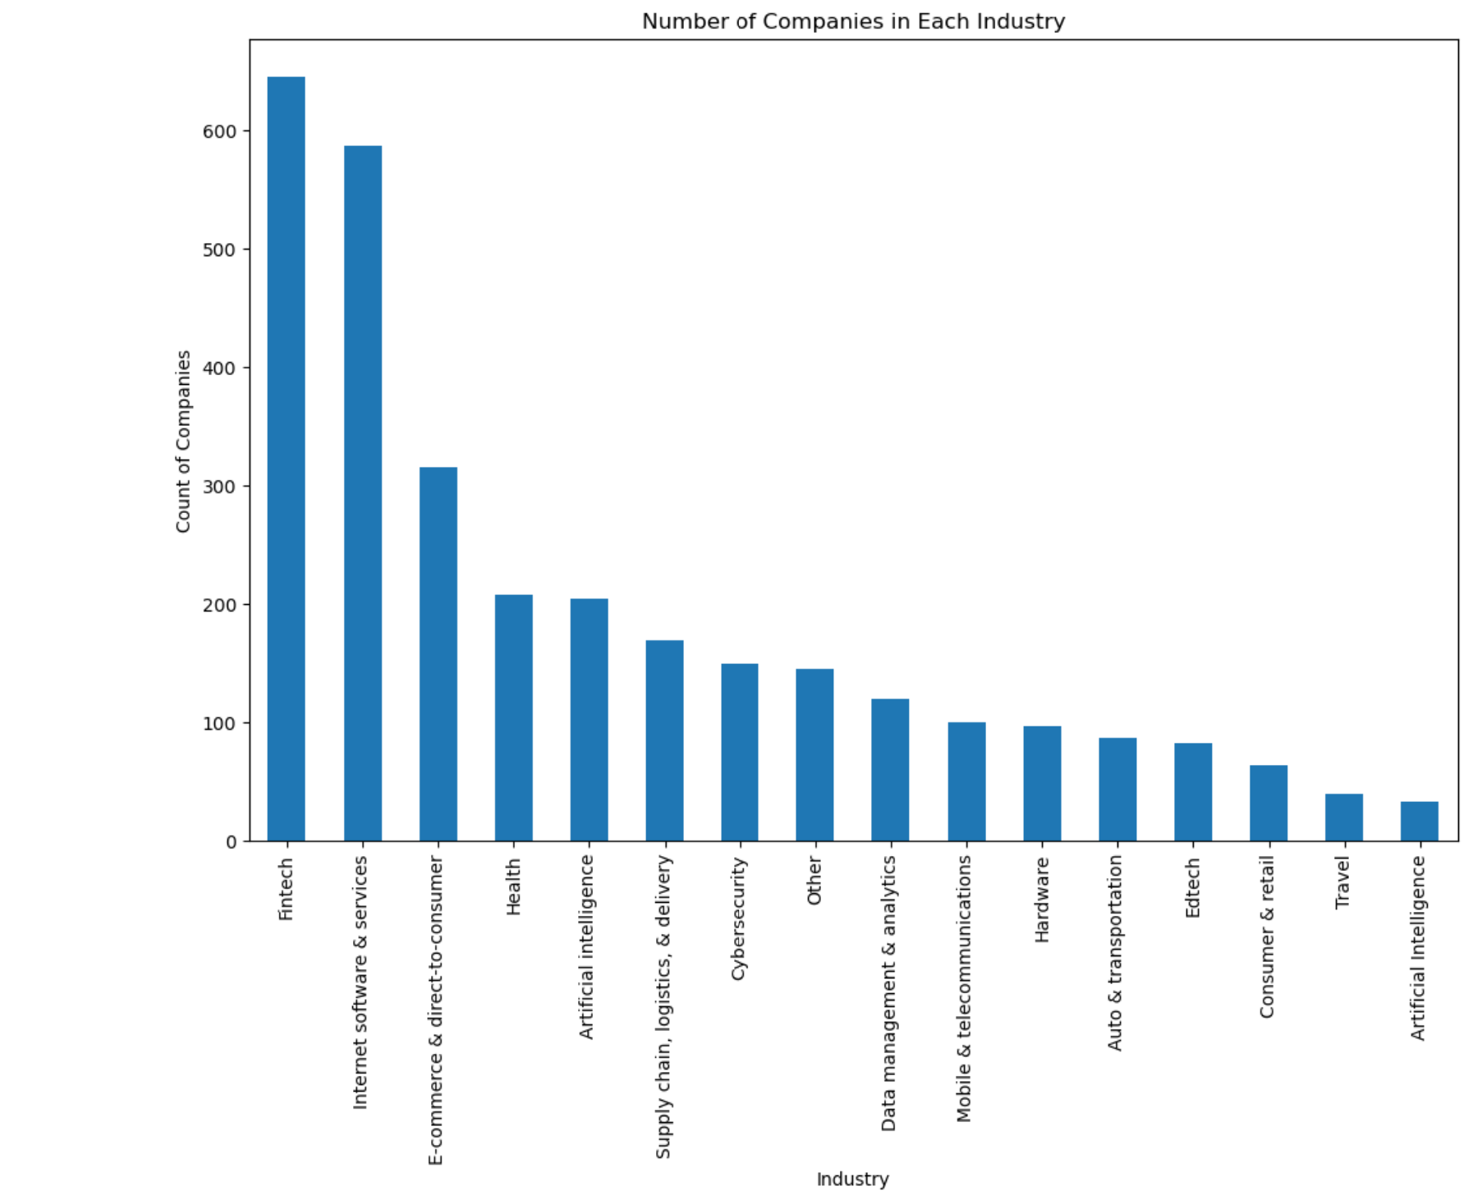
UNIVARIATE ANALYSIS:BAR CHART

Slide 3
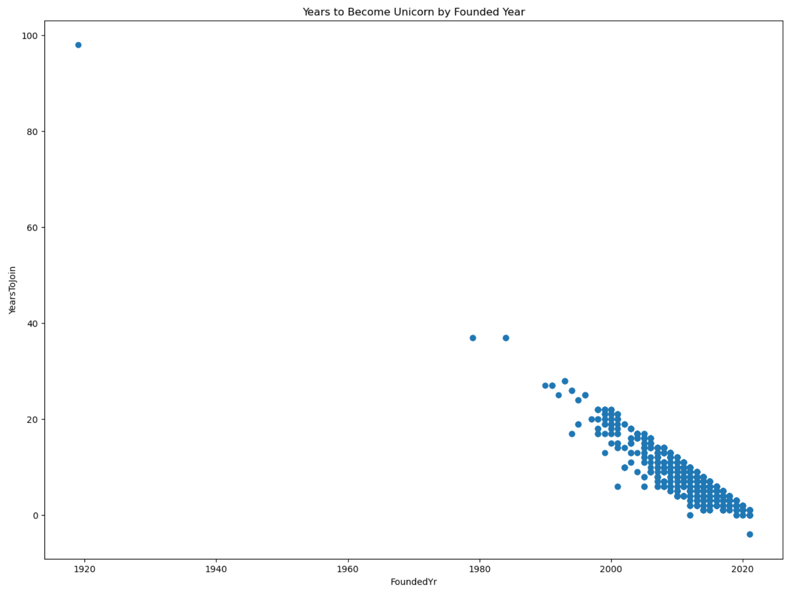
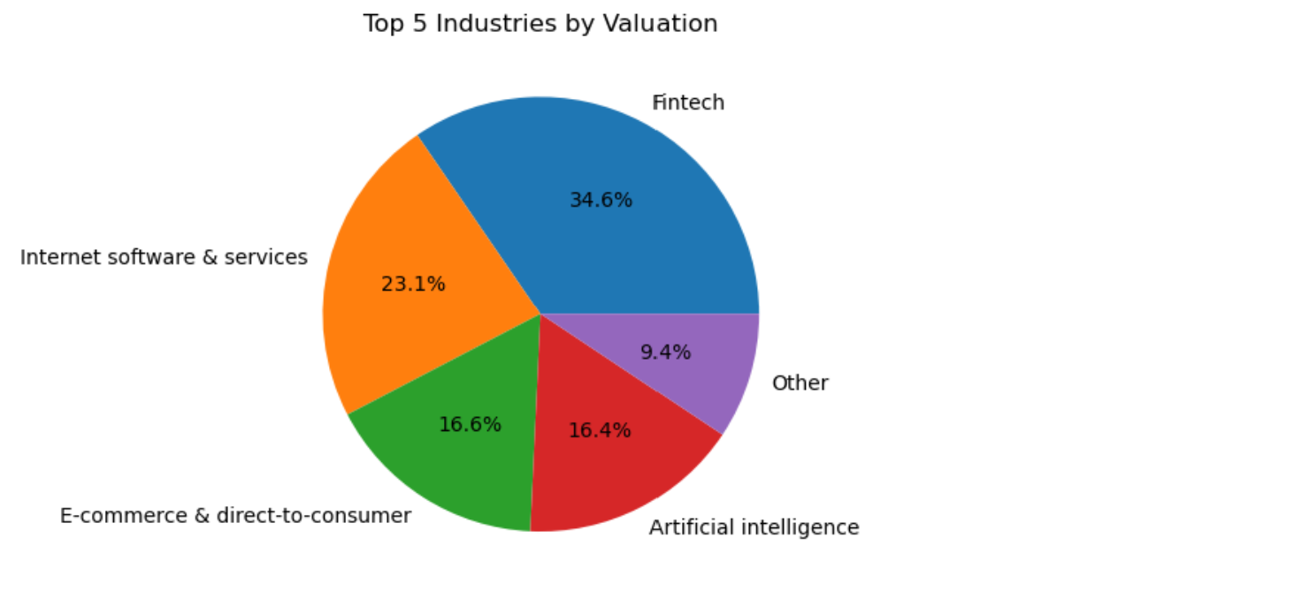
BIVARIATE ANALYSIS:PIE CHART AND SCATTER PLOT

Slide 4
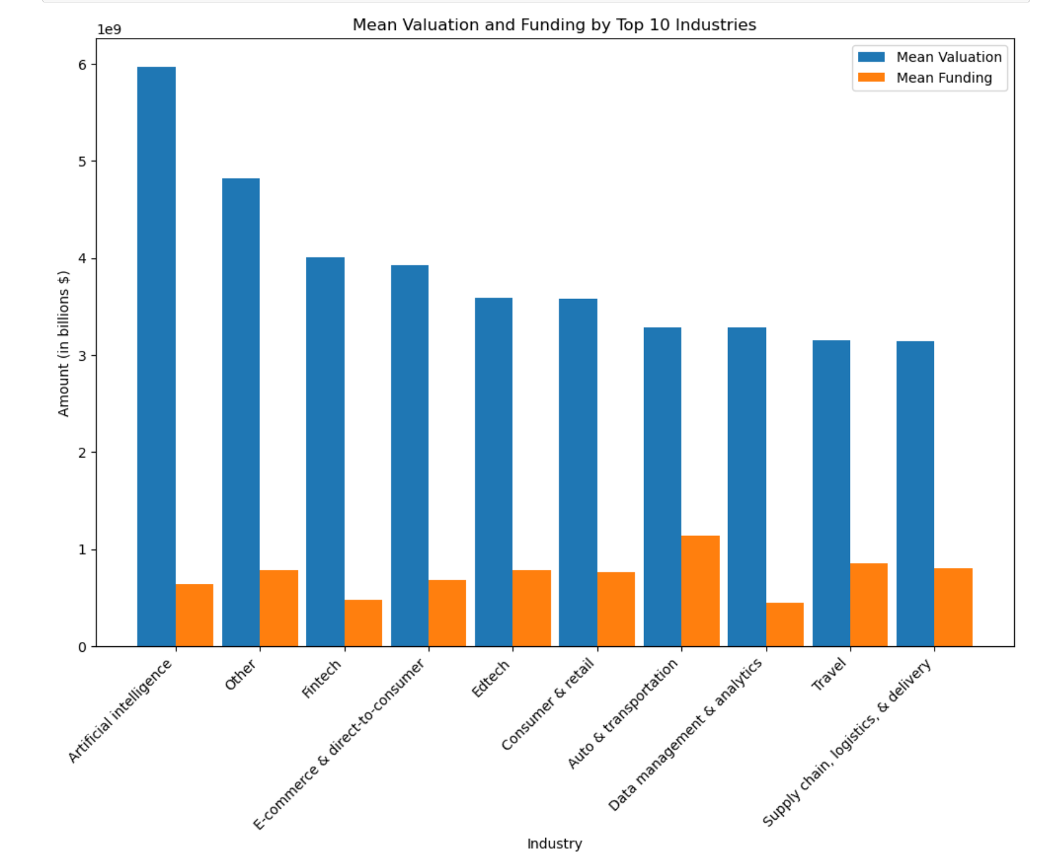
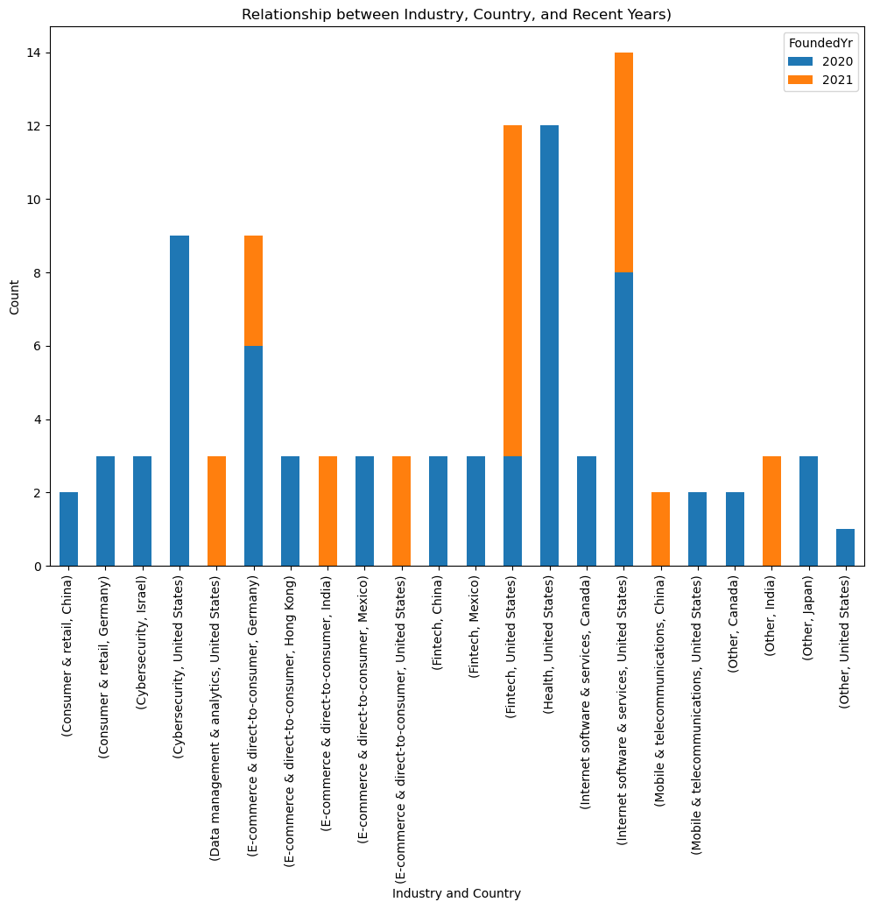
MULTIVARIATE ANALYSIS:GROUPED BAR CHART AND STACKED BAR CHART

Slide 5
RECOMMENDATIONS
Based on the data the below are my recommendations.
The Pie chart shows that the top 4 industries with the highest valuations over time are Fintech , internet software & services, Ecommerce & direct-to-consumer , Artificial Intelligence industries so i recommend investors focusing on those industries
-Also the scatter plot is letting us know that companies founded in the late 2000's attained unicorn status faster
-The Artificial Intelligence Industry has a better risk to reward ratio.
-Data told us most of the unicorn companies were founded in the united states and from the stacked bar chart we can observe that in the year 2021 the fintech industry ,Ecommerce & direct-to-consumer , internet software & services industry was where the focus was on, whereas in 2020 the go to industry was Cybersecurity, Health and internet software & services
I recommend a diversification of portfolio for any interested investor who wants to fund a start up company with the below percentages
25%-Fintech Industry 25% -Internet Software and Services 20% -Ecommerce and Direct to Consumer 20%- Artificial Intelligence 10%- Cybersecurity
I recommend the company should be located in the united states , and the wait time for such companies to reach unicorn status should be between 3 and 8 years

